Slide 1


Data Cleaning: Starting Files
Zillow real estate data: average sales price of homes by city from 2008 to the beginning of 2020
Air BnB rental data: mostly from 2020. Some properties did not have reviews left in 2020.

Slide 2
Data Cleaning: Challenges
Some dates in the AirBnB data set were formatted dd/mm/yyyy and others mm/dd/yyyy. The format was changed so they were all uniform and then they were converted to match the yyyy/mm format used in the Zillow data set.
AirBnB: “New York City” was sometimes labeled simply as “New York” and we grouped them together.
The merged DataFrame was done by city and based on eleven cities that matched between the two data sets.

Slide 3
Question
Was there any correlation between average housing price and the Air BnB reviews left per month in each city?

Slide 4
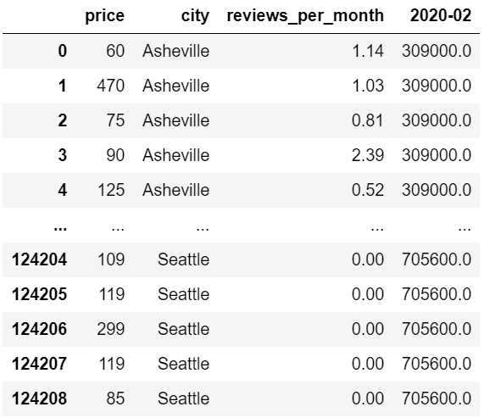
DataFrame

Slide 5
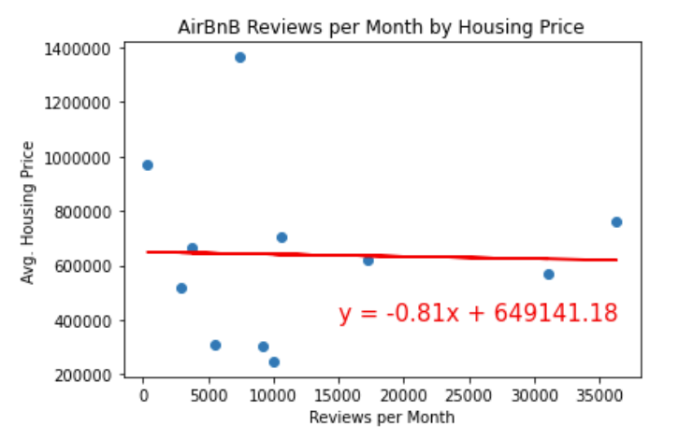
There appears to be no correlation between average housing price and reviews left per month on Air BnB rentals.

Slide 6
Bonus Question
Was there any correlation between Air BnB rental price and the reviews left per month in each city?

Slide 7
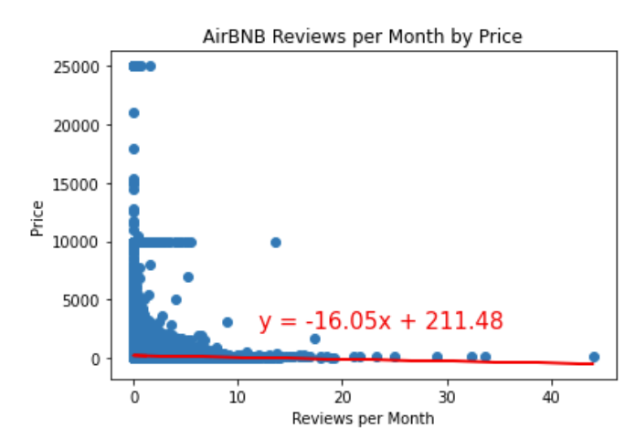
There is a strong, negative, nonlinear association between the two variables.

